Slide 1
Chapter 7
Demand Forecasting in a Supply Chain
Supply Chain Management
(3rd Edition)
7-<number>

Slide 2
Role of Forecasting in a Supply Chain
The basis for all strategic and planning decisions in a supply chain
Used for both push (Anticipation of customer order) and pull (Response to customer demand) processes
When each stage in the SC makes its own forecast, these forecast are often different
The result is a mismatch between supply and demand
When all stages in a SC produce a collaborative forecast, it tends to be more accurate
Enables SC to be more responsive and efficient as well..
7-<number>

Slide 3
Some decisions that utilize forecasts and can be enhanced through collaborative forecasting among SC partners:
Examples:
  Production: scheduling, inventory, aggregate planning
  Marketing: sales force allocation, promotions, new product introduction
  Finance: plant/equipment investment, budgetary planning
  Personnel: workforce planning, hiring, layoff
All of these decisions are interrelated, must not be segregated by functional area..they are best made jointly
7-<number>

Slide 4
Characteristics of Forecasts
Forecasts are always wrong. Should thus include both the expected value of the forecast and a measure of error.
Long-term forecasts are less accurate than short-term forecasts (forecast horizon is important)
Aggregate forecasts are more accurate than disaggregate forecasts
Further up the SC the company is (from customer) , the greater the distortion of information they receive
7-<number>

Slide 5
Forecasting Methods
Qualitative: primarily subjective; rely on judgment, market intelligence and opinion
Time Series: use historical demand data only
Causal: use the relationship between demand and some other factors like interest rate, state of the economy etc to develop forecast
Simulation: Can combine time series and causal methods, models that can incorporate some randomness and non-linear effects
7-<number>
Notes:
Notes:

Slide 6
Basic Approach to
Demand Forecasting
Understand the objectives of forecasting
Integrate planning and forecasting
Identify major factors that influence the demand forecast
Understand and identify customer segments
Determine the appropriate forecasting technique
Establish performance and error measures for the forecast
7-<number>

Slide 7
Role of IT in forecasting
Use of IT application tools to get customers demand information eg customized website of Dell.com, CRM applications
Use of IT application tools in quantitative data analysis eg Time Series/Trend Analysis
IT application tools helps in Aggregate forecasting (integration of all stages), which is more accurate and reliable
IT application tools are useful in measuring forecasting error
IT application tools are useful in addressing prompt information that affects demand
7-<number>

Slide 8
Aggregate Planning
Aggregate planning is a marketing activity that does an aggregate plan for the production process, in advance of 6 to 18 months, to give an idea to management as to what quantity of materials and other resources are to be procured and when, so that the total cost of operations of the organization is kept to the minimum over that period.
The aim of aggregate planning is to set overall output levels in near future in the face of fluctuating or uncertain demands.
7-<number>

Slide 9
Aggregate planning is the process of developing, analyzing, and maintaining a preliminary, approximate schedule of the overall operations of an organization.
The aggregate plan generally contains targeted sales forecasts, production levels, inventory levels, and customer backlogs.
This schedule is intended to satisfy the demand forecast at a minimum cost.
This longer-term perspective on resource use can result in cost savings.
7-<number>

Slide 10
The Aggregate Planning Problem
The standard aggregate planning problem aims to determine the production levels, inventory kept in the supply chain, hiring and firing employees, overtime production, backorders and demand satisfaction levels with the objective of having the minimum cost or maximum profit.
It is the most widely solved supply chain management problem.
7-<number>

Slide 11
Role of aggregate planning in supply chain
Minimize Staffing Fluctuations: By using aggregate planning to forecast production demand, businesses are better able to predict their staffing requirements.
Reduce Overhead: Excess inventory costs businesses a lot of money. Adhering to an aggregate planning model can help businesses operate in a leaner manner. Managers will be able to better anticipate how much product they will need and when they will need it so they won't have to stockpile it in advance due to a fear that they'll run out before they can get more.
Increase Production Rates: A significant advantage to using aggregate planning is that it maximizes the utilization of production equipment. Since production equipment is being used at its full capacity, production rates significantly increase. This creates a much more streamlined process where businesses can accurately determine the time it will take to fulfill orders and can then plan their production operations accordingly.
Accommodate Changes: Since production orders often vary, most businesses cannot stick to one plan at all times. Aggregate planning allows for contingency measures to be put in place so businesses can better accommodate significant changes in customer orders and production.
7-<number>

Slide 12
Inventory Management and Planning
Defining Inventory
Inventory is an idle stock of physical goods that contain economic value, and are held in various forms by an organization.
Any organization which is into production, trading, sale and service of a product will necessarily hold stock of various physical resources to aid in future consumption and sale.
Excessive inventory levels are costly
Insufficient inventory levels lead to stock outs
Types of Inventory by Function
  Raw Materials
  Work In Process
  Finished Goods
7-<number>

Slide 13
Inventory Management
Inventory management is a very important function that determines the health of the supply chain as well as the impacts the financial health of the balance sheet.
Every organization constantly strives to maintain optimum inventory to be able to meet its requirements and avoid over or under inventory that can impact the financial figures.
Inventory management requires constant and careful evaluation of external and internal factors and control through planning and review.
7-<number>

Slide 14
Inventory Planning
The process of determining the optimal quantity and timing of inventory for the purpose of aligning it with sales and production capacity.
Inventory planning has a direct impact a company's cash flow and profit margins especially for smaller businesses that rely upon a quick turnover of goods or materials
Benefits:
  Better Cash Flow
  Higher Profits
  Limits Abuse of Inventory
7-<number>

Slide 15
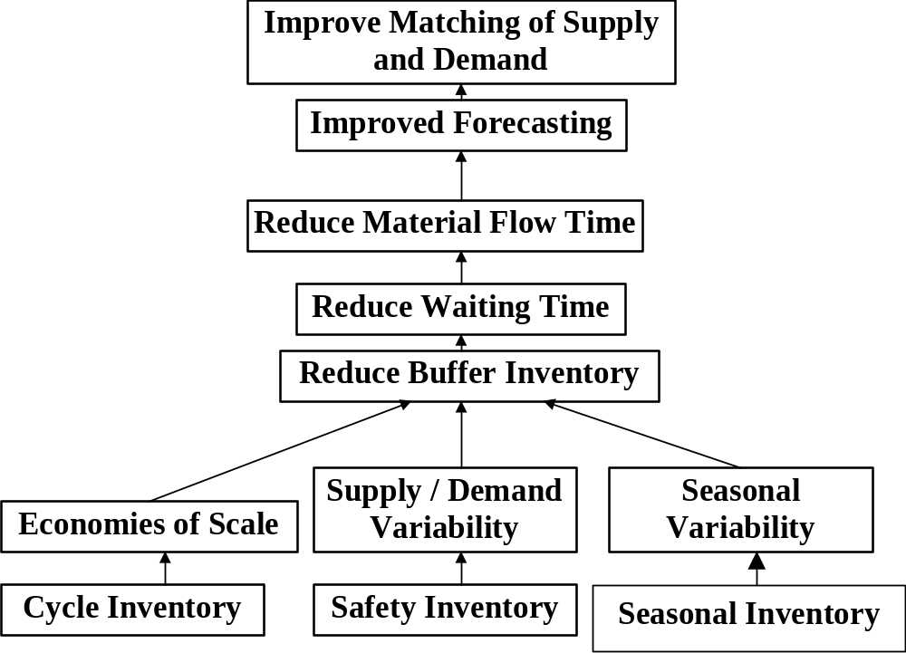
Role of Inventory in the Supply Chain
Cost
Availability
Efficiency
Responsiveness
11-<number>
Notes:
Notes:

Slide 16
The Role of Safety Inventory in a Supply Chain
Forecasts are rarely completely accurate
If average demand is 1000 units per week, then half the time actual demand will be greater than 1000, and half the time actual demand will be less than 1000; what happens when actual demand is greater than 1000?
If you kept only enough inventory in stock to satisfy average demand, half the time you would run out
Safety inventory: Inventory carried for the purpose of satisfying demand that exceeds the amount forecasted in a given period
11-<number>

Slide 17
Role of Safety Inventory
Average inventory is therefore cycle inventory plus safety inventory
There is a fundamental tradeoff:
  Raising the level of safety inventory provides higher levels of product availability and customer service
  Raising the level of safety inventory also raises the level of average inventory and therefore increases holding costs
    Very important in high-tech or other industries where obsolescence is a significant risk (where the value of inventory, such as PCs, can drop in value)
    Compaq and Dell in PCs
11-<number>

Slide 18
Determining the Appropriate
Level of Demand Uncertainty
Appropriate level of safety inventory determined by:
  supply or demand uncertainty
  desired level of product availability
Higher levels of uncertainty require higher levels of safety inventory given a particular desired level of product availability
Higher levels of desired product availability require higher levels of safety inventory given a particular level of uncertainty
11-<number>

